Slide 1


Intro to
Programming
With python
Files:
Part 1
Friday, March 28 2025 TOH210
Download make_first.py, the_hobbit.txt, and numbers.txt files from Moodle!
Notes:
Layout objects pulled from: https://slidesgo.com/
All icons are from: https://thenounproject.com/

Slide 2

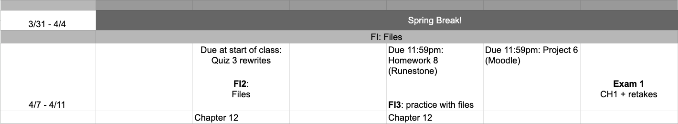
After Break
google sheet link
Notes:
https://docs.google.com/forms/d/e/1FAIpQLSe3OloPAJSid4n6cyU_4qXpRWU7FOSmP7IVdRS_vh9cvYd9zQ/viewform?usp=sharing

Slide 3
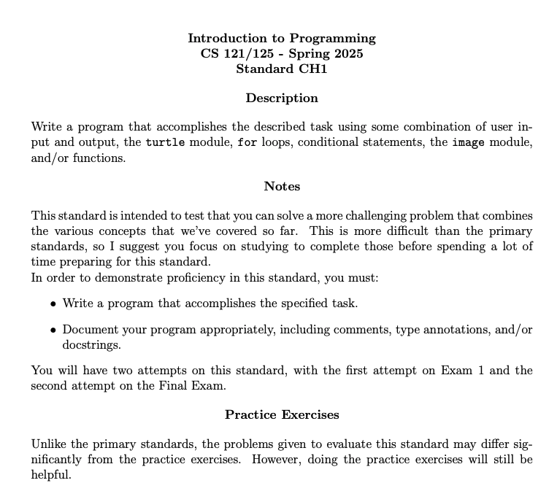
Challenge standard 1
This standard combines previous standards and tests not only the logic, but also documentation of your code.
For Exam 1, you can expect the challenge standard to take anywhere from 15-25 minutes to complete.
Any remaining time can be used to retake previous standards. If you have no standards to retake, you can leave as soon as CH1 is done.

Slide 4


warm-up
edit make_first.py file up on Moodle
make_first1
Define a function make_first1 which takes a list (input_list) and an item (value) as arguments, and replaces the item at index 0 from input_list with value
First edit the function header, adding in type annotations and a docstring.
Ask yourself if this function should return something, or is it simply doing a list operation. If returning something, consider a clone.
Update the function definition, so that each function does what it is supposed to do.
make_first2
Define a function make_first2 which takes a list (input_list) and an item (value) as arguments, and returns a new list with the same items as input_list except the item at index 0 is now value

Slide 5
Takeaways from last time
transforming strings by creating a new string and using concatenation or iteration

Slide 6

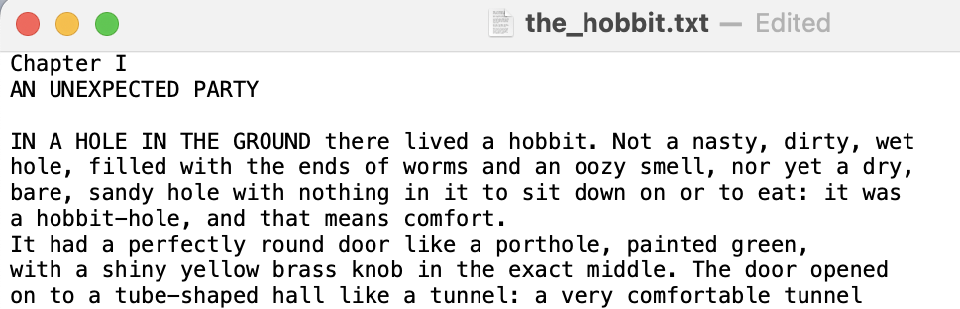
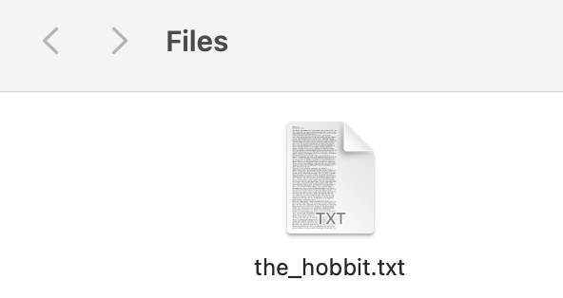
Today, we’re going to start learning about how to work with text files
A plain text file is a file with the extension .txt
Plain text files contain only text, with no formatting or structure
You can think of these as a file contains a super long string
There is a text file up on Moodle called the_hobbit.txt
Download this and put it into a folder you can easily locate
Once you have it downloaded, try to locate it and open it.

Slide 7
create a new Python file called hobbit_file.py
file name
read mode
Reading from a File
To get the text out of a file we need to store it as a string in order to manipulate it.
To do this we’ll need to create a file object and use it to read from the file we would like to use
We’ll be using the_hobbit.txt file we just downloaded for this example
hobbit_file = open("the_hobbit.txt", "r")
creates file object
hobbit_text = hobbit_file.read()
returns entire text of file as a single string
hobbit_word = hobbit_text.split()
splits single string into list of words
hobbit_file.close()
always always always close your file!

Slide 8
Counting characters and words
Let’s use the len function to see how many characters and words we have.
Looking at the code below, which gives the count of words? Which gives the count of characters?
file name
read mode
hobbit_file = open("the_hobbit.txt", "r")
creates file object
hobbit_text = hobbit_file.read()
returns entire text of file as a single string
hobbit_word = hobbit_text.split()
splits single string into list of words
hobbit_file.close()
len(hobbit_text)
len(hobbit_word)
count of characters
count of words
always always always close your file!

Slide 9
file name
read mode
If we want to see the information stored in these two variables, we may find it difficult.
Try printing out hobbit_text.
What do you see?
Now, try printing out hobbit_word. What happens?
hobbit_file = open("the_hobbit.txt", "r")
creates file object
hobbit_text = hobbit_file.read()
returns entire text of file as a single string
Squeezed (text too big)
hobbit_word = hobbit_text.split()
splits single string into list of words
Goes on forever (too big of a loop)
hobbit_file.close()
always always always close your file!

Slide 10
Exercise
hobbit_file = open("the_hobbit.txt", "r")
hobbit_text = hobbit_file.read()
hobbit_words = hobbit_text.split()
hobbit_file.close()
#information
num_char = len(hobbit_text)
num_words = len(hobbit_words)
#your code here
#1
#2
#3
#4
Display the first 10 characters of hobbit_text.
Display the first 10 words in the list hobbit_words.
Print out the average word length for this text.
[Optional] Find the number of times the word hobbit appears. Hint: what str method could we use? Or, use counter accumulator on list.

Slide 11
Exercise
fill in the blank
There is another text file up on Moodle called numbers.txt which contains integers separated by spaces.
Create a new Python file named numbers_file.py
This program opens and reads from numbers.txt, and computes and prints the sum of all numbers in the file.
‘r’
my_file = open("numbers.txt", ____)
my_text = my_file._________
my_nums = my_text.________
__________.close()
#sum numbers
sum = 0 for _ in _______________________:
sum += _________
#display sum
print(sum)
read()
split()
my_file
range(len(my_nums))
int(my_nums[_])

Slide 12
file name
write mode
writing to a File
We can also open files in write mode which allows us to write text to a file.
If a file with the given name doesn’t exist yet, it is created
We’ll be creating a new file called storybook.txt and adding some text to it
new_file = open("storybook.txt", "w")
creates file object
story = "In a land far away"
new_file.write(story)
writes the string to the storybook text file
new_file.close()
always always always close your file!

Slide 13
expand your story
Add more to the story.
Pick topical words to put in the blanks. You can use this emoji generator if you’d like help coming up with random items.
You can replace Golem with a name of your choosing.
story = """In a land far away there lived a ______________ named Golem who was obsessed with ________. Golem was a _____________ creature, never asking for _______________. Until one day Golem came across a magical _______________."""
creature
food/drink
adjective 2
object
object 2

Slide 14

before next time
Finish workbook
Reading 7 + discussion
Quiz 3 rewrites
Project 6 (optional)

Slide 15
hobbit_file = open("the_hobbit.txt", "r")
hobbit_text = hobbit_file.read()
hobbit_words = hobbit_text.split()
hobbit_file.close()
#information
num_char = len(hobbit_text)
num_words = len(hobbit_words)
#1
print("The first 10 characters:", hobbit_text[:10])
#2
for item in range(10):
print(hobbit_words[item])
#3
print("Average word length is: ", num_char/num_words)
#4
print(hobbit_text.count('hobbit'))

